Slide 1

南京外国语学校命题组

Slide 2
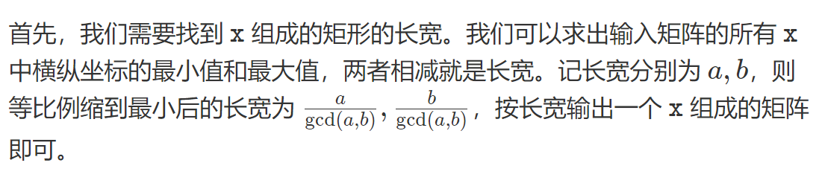
A-Image Scaling

Slide 3
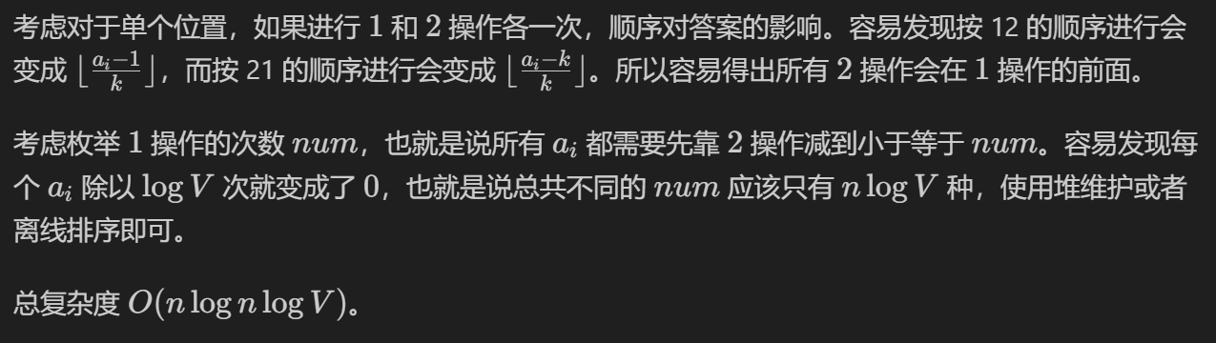
K-Kill The Monsters

Slide 4
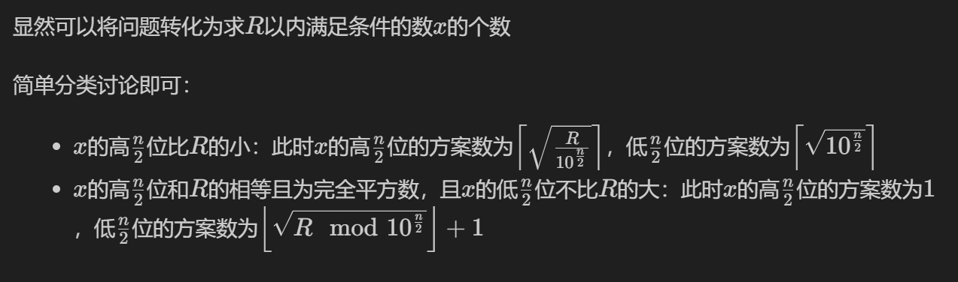
I-Interesting Numbers

Slide 5
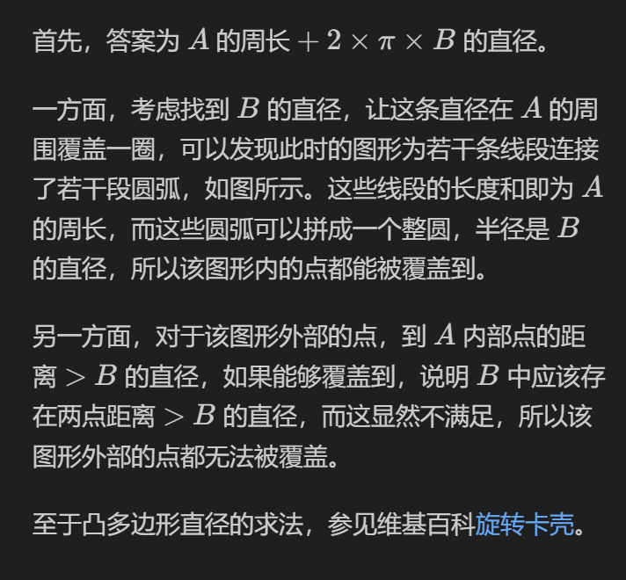
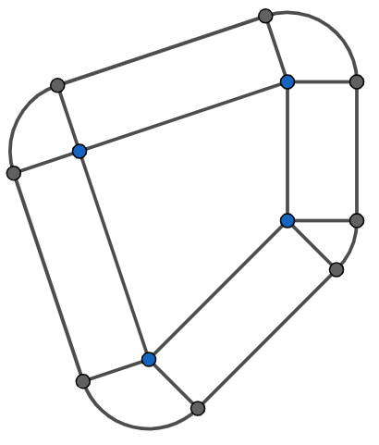
H-Two Convex Polygons

Slide 6
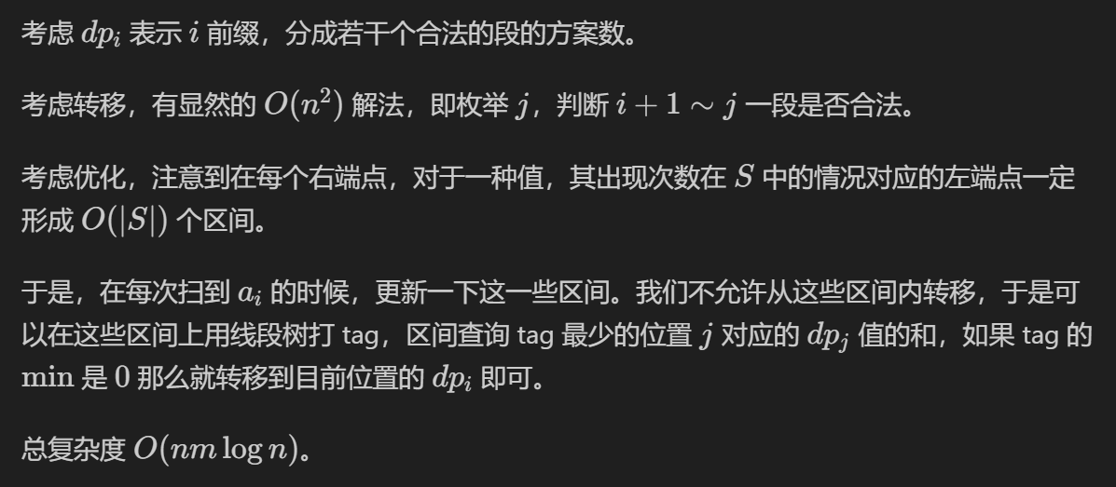
B-Break Sequence

Slide 7
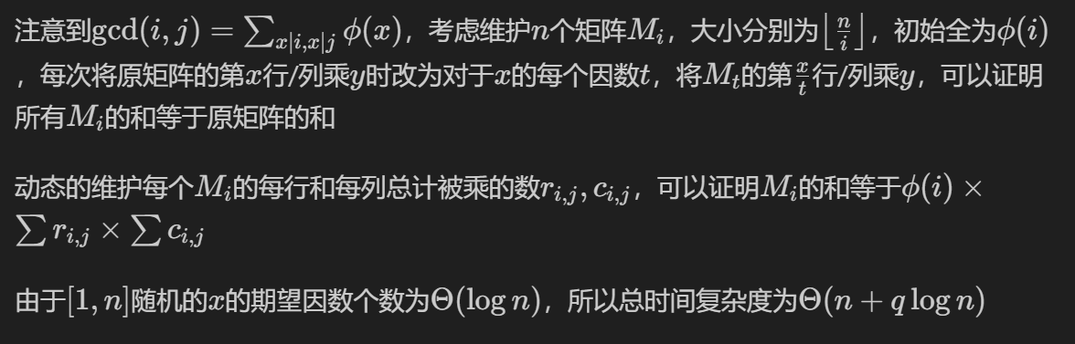
C-Change Matrix

Slide 8
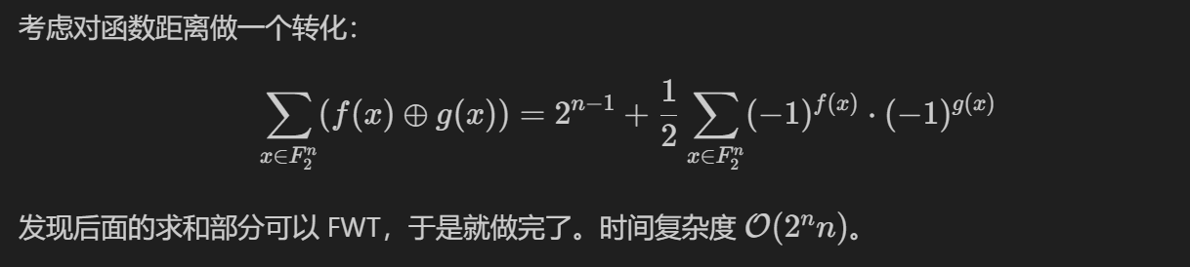
D-Luner XOR

Slide 9
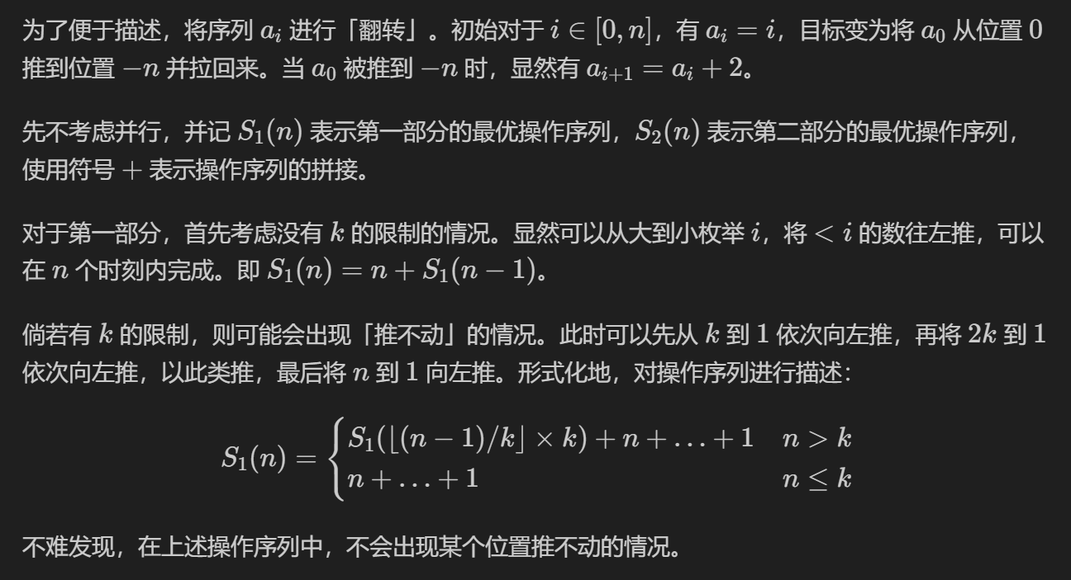
G-Sticky Pistons

Slide 10
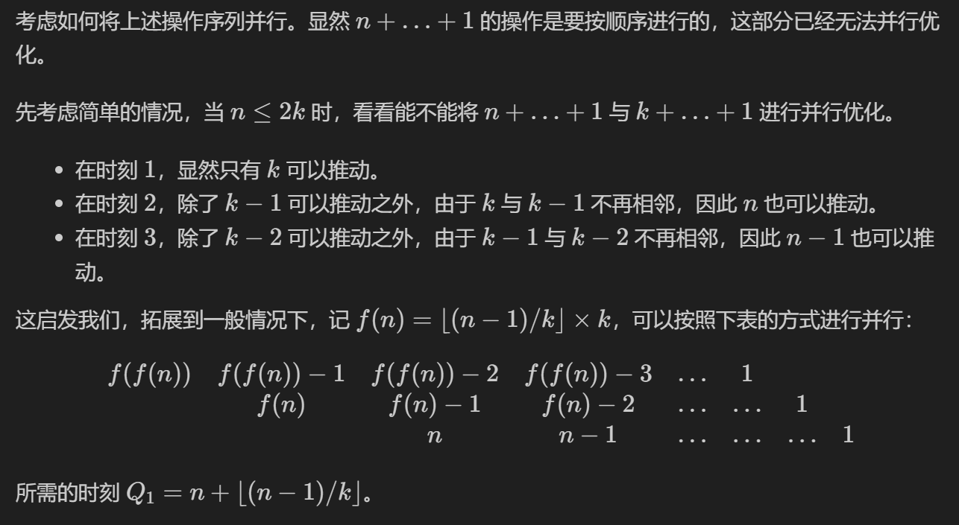
G-Sticky Pistons

Slide 11
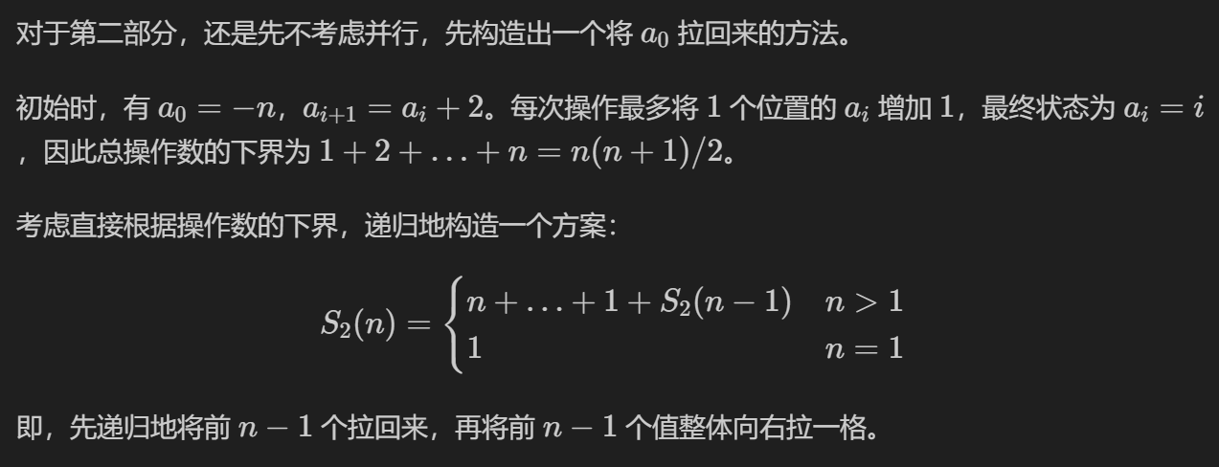
G-Sticky Pistons

Slide 12
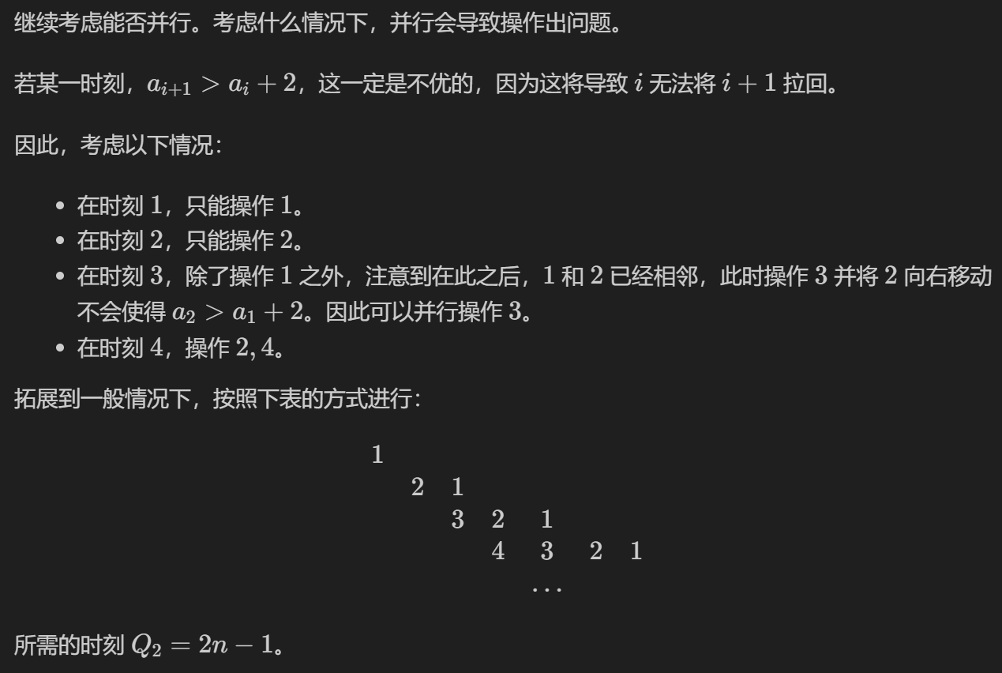
G-Sticky Pistons

Slide 13
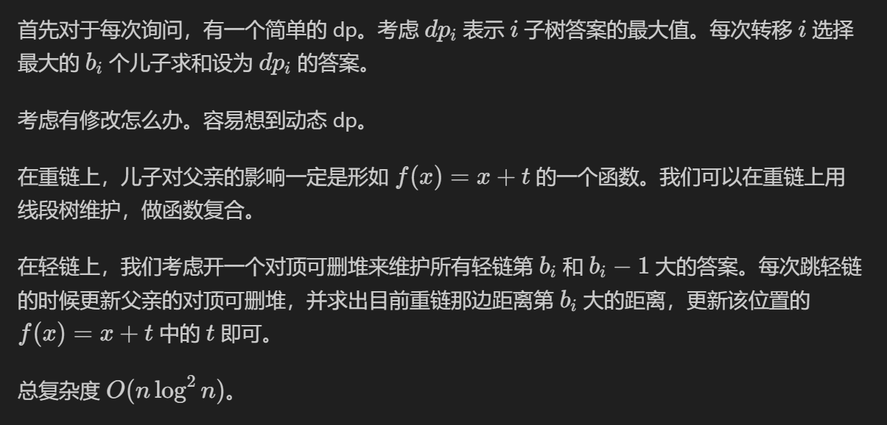
E-Easy Tree Problem

Slide 14
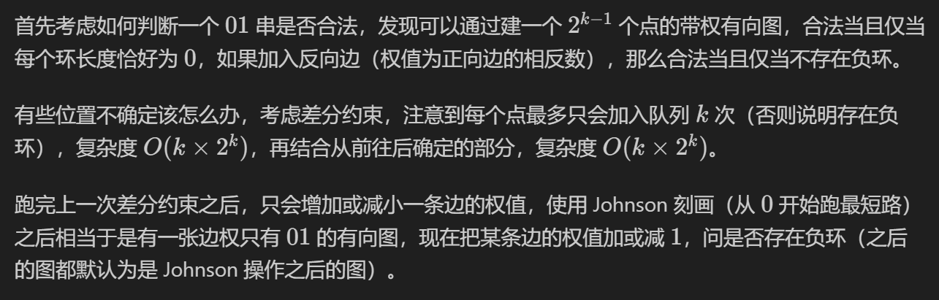
J-String Problem

Slide 15
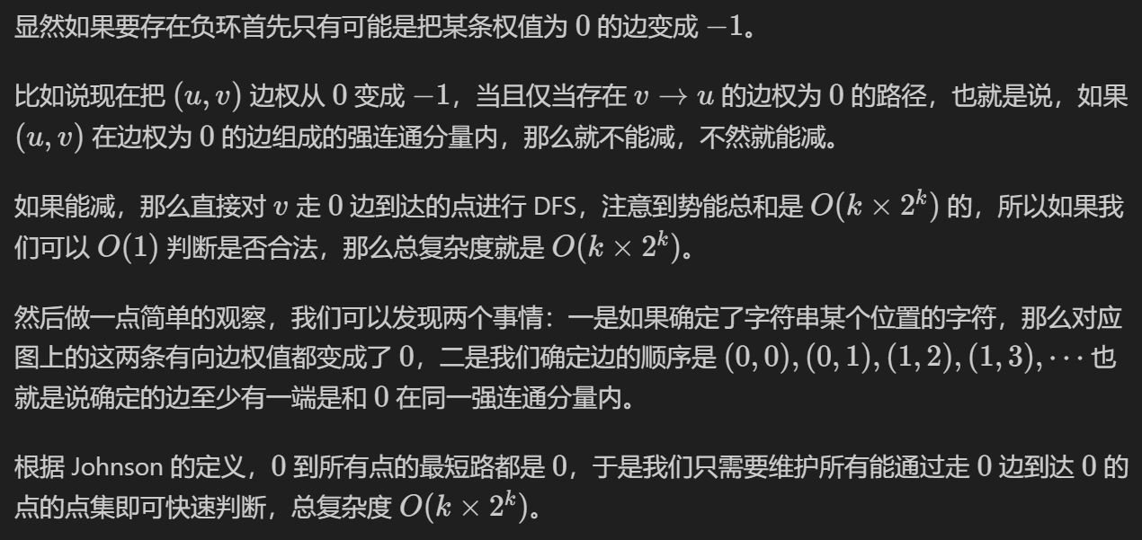
J-String Problem

Slide 16
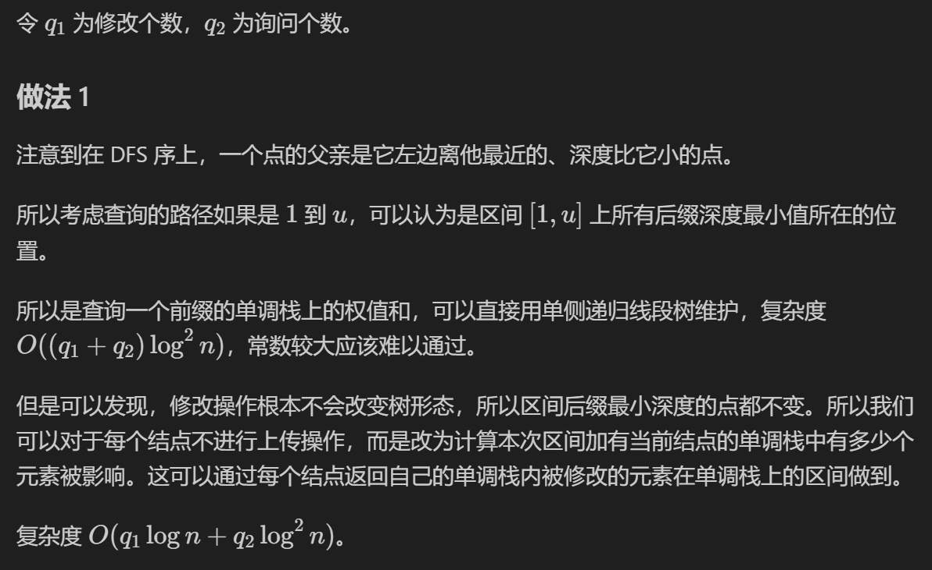
F-Minesweeper

Slide 17
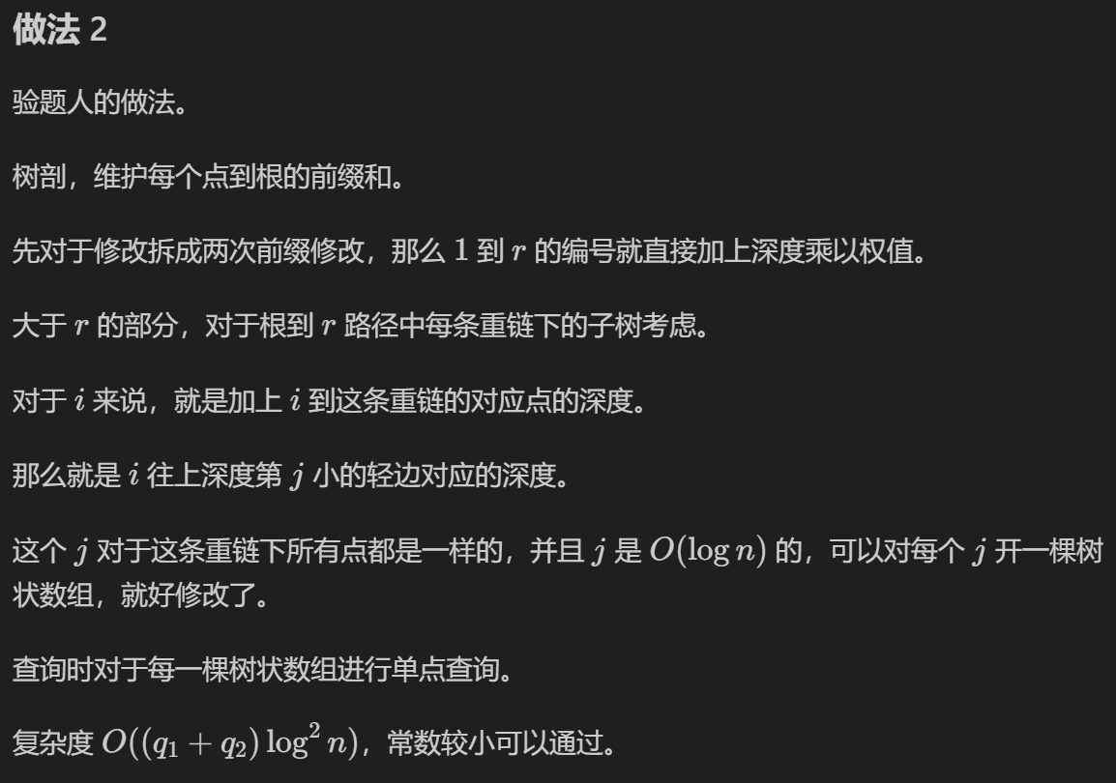
F-Minesweeper

Slide 18
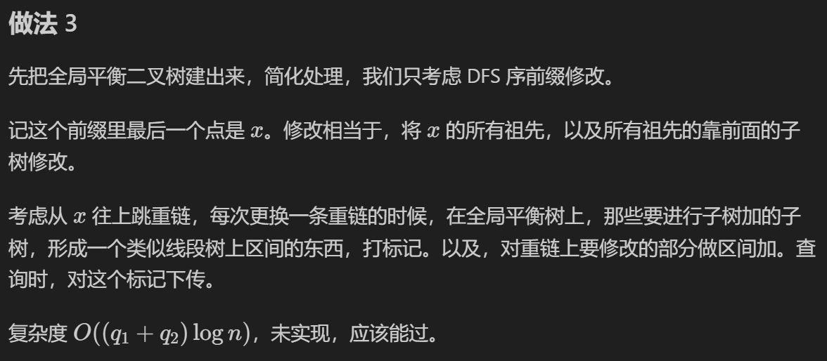
F-Minesweeper

Slide 19

THANKS
AC.NOWCODER.COM

